Slide 1
Web Programming
with Python and JavaScript

Slide 2
Web Programming

Slide 3

HTML
HTML and CSS

Slide 4

Git

Slide 5

Python

Slide 6

Django

Slide 7


SQL, Models, and Migrations

Slide 8

JavaScript

Slide 9
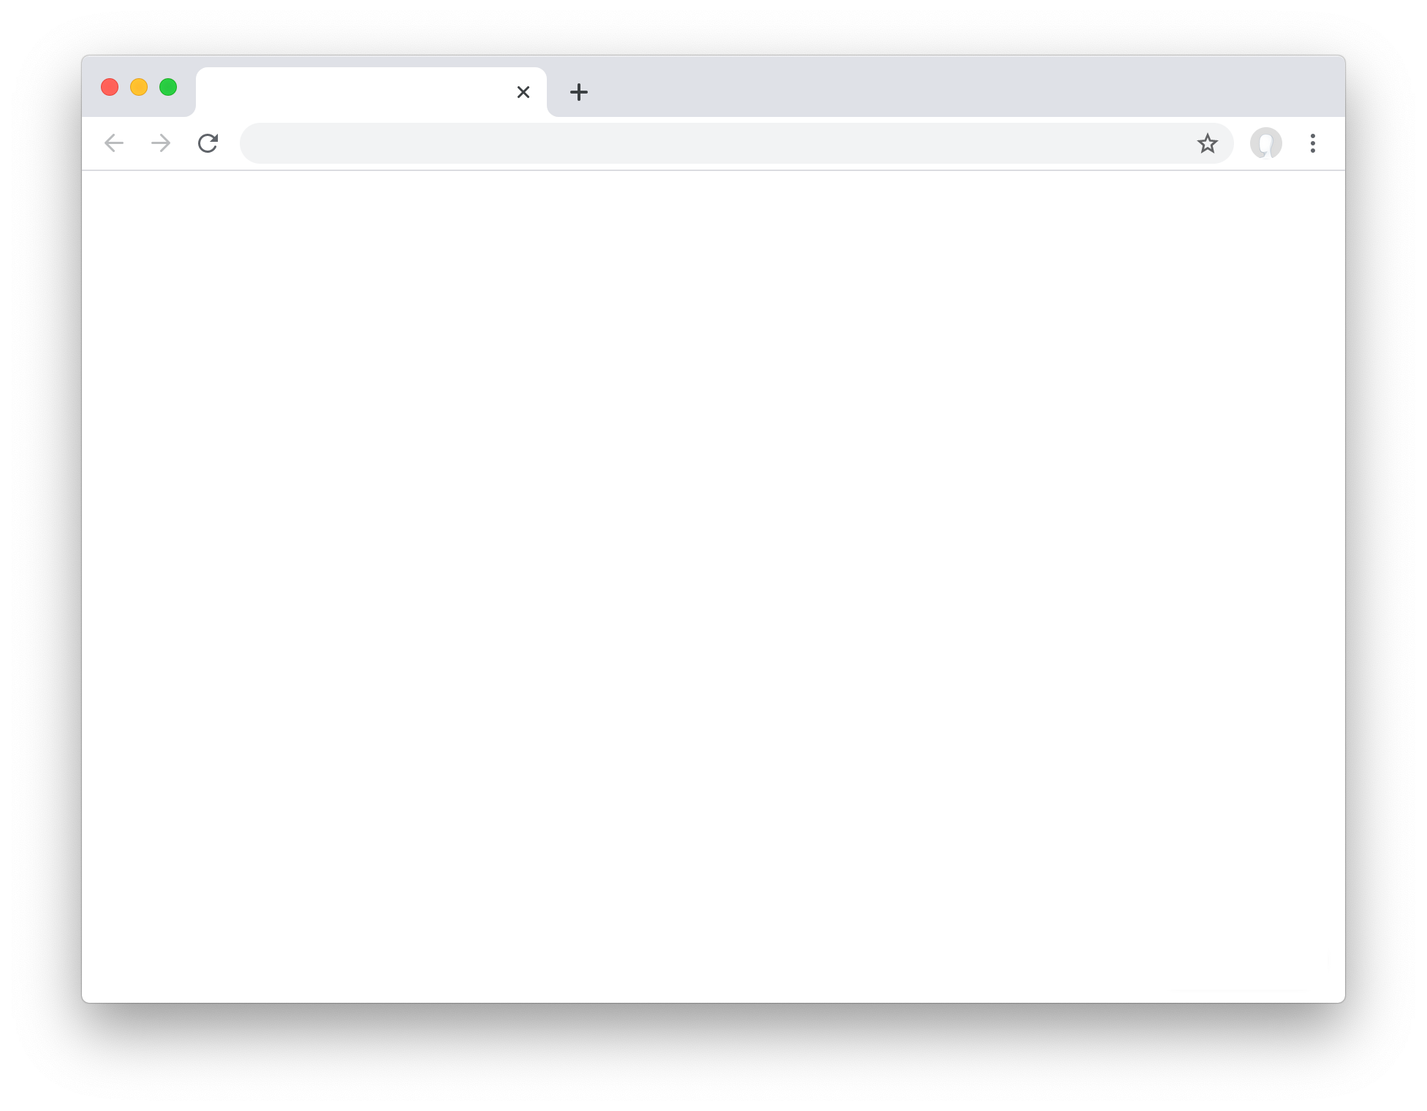
User Interfaces

Slide 10
HTML

Slide 11
HYPER TEXT MARKUP LANGUAGE

Slide 12
<!DOCTYPE html>
<html lang="en">
<head>
<title>Hello!</title>
</head>
<body>
Hello, world!
</body>
</html>

Slide 13
HTML USES ELEMENTS TO DESCRIBE THE STRUCTURE OF PAGES
<html>
<body>
<h1> This is the Main Heading </h1>
<p> This text might be an introduction to the rest of page. And if the page is a long one it might be split up into several sub-headings. </p>
</body>
</html>

Slide 14
ELEMENT
<tag>Content</tag>

Slide 15
ELEMENT
<tag>Content</tag>

Slide 16
ELEMENT
<tag>Content</tag>

Slide 17
A CLOSER LOOK AT TAGS
<p>
CHARACTER
LEFT-ANGLE BRACKET
(LESS-THAN SIGN)
RIGHT-ANGLE BRACKET
(GREATER-THAN SIGN)
OPENING TAG

Slide 18
</p>
CHARACTER
LEFT-ANGLE BRACKET
(LESS-THAN SIGN)
RIGHT-ANGLE BRACKET
(GREATER-THAN SIGN)
FORWARD SLASH
CLOSING TAG

Slide 19
Common HTML Tags
<h1>, <h2>, ..., <h6>
<p>
<ol>, <ul>
<div>, <span>
<a>
<table>
<form>
...

Slide 20
<!DOCTYPE html>
<html lang="en">
<head>
<title>Hello!</title>
</head>
<body>
Hello, world!
</body>
</html>

Slide 21
<!DOCTYPE html>
<html lang="en">
<head>
<title>Hello!</title>
</head>
<body>
Hello, world!
</body>
</html>

Slide 22
<!DOCTYPE html>
<html lang="en">
<head>
<title>Hello!</title>
</head>
<body>
Hello, world!
</body>
</html>

Slide 23
<!DOCTYPE html>
<html lang="en">
<head>
<title>Hello!</title>
</head>
<body>
Hello, world!
</body>
</html>

Slide 24
<!DOCTYPE html>
<html lang="en">
<head>
<title>Hello!</title>
</head>
<body>
Hello, world!
</body>
</html>

Slide 25
<!DOCTYPE html>
<html lang="en">
<head>
<title>Hello!</title>
</head>
<body>
Hello, world!
</body>
</html>

Slide 26
<!DOCTYPE html>
<html lang="en">
<head>
<title>Hello!</title>
</head>
<body>
Hello, world!
</body>
</html>

Slide 27
Document Object Model
html
<!DOCTYPE html>
<html lang="en">
<head>
<title>Hello!</title>
</head>
<body>
Hello, world!
</body>
</html>
head
body
title
Hello, world!
Hello!

Slide 28
SELF CLOSING TAGS
<br/>
CHARACTER
FORWARD SLASH
LEFT-ANGLE BRACKET
(LESS-THAN SIGN)
RIGHT-ANGLE BRACKET
(GREATER-THAN SIGN)
SELF CLOSING TAG

Slide 29
Common SELF CLOSING Tags
<br/>
<hr/>
<img/>
...

Slide 30
HEADINGS
<h1>
<h2>
<h3>
<h4>
<h5>
<h6>

Slide 31
PARAGRAPHS
<p> - Creates paragraphs
<hr/> - Inserts a horizontal line
<br/> - Inserts a line break
<pre> - Preserves white spaces and line breaks, often used for displaying code.

Slide 32
TEXT FORMATTING
<b>, <strong> - Emphasize the importance of content.
<i>, <em> - Indicate text in a italic style
<u>, <ins> - Highlight additions or changes
<sub>, <sup> - Position text below or above the normal text line
<small>, <big> - Adjust the size of text
<mark> - Highlights text for reference
<del> - Represents deleted or removed text

Slide 33
TASK
Add CV/Resume title in your web page
Write your full name as main heading
Enter your designation using p tag
Add horizontal line
Add Summary section sub-heading
Add your summary (Write a brief introduction about yourself or what your represent)

